Slide 1
BLOOD BANK MANAGEMENT SYSTEM
THANUSHRI R 17BCE0188
TANVI GUPTA 17BCE0909
BARKHA 17BCE0314

Slide 2
INTRODUCTION
Blood Bank Management is crucial and very necessary for hospitals so that they can connect patients to donors effectively. In today’s date, India faces a shortage of 10% relative to its blood requirement. The issue is not a dearth of donors but an ineffective management of blood banks. In this project Blood Bank Management System, we aim to bridge the gap between potential donors and patients in need.
The product is an user interface website that provides an interactive environment between the donors and the donees. The purpose of the product is to help the donees with the faster delivery of blood with a highly reliable and secure database. Our software deals with online blood bank and managing the various operations of the blood bank with efficiency and effectiveness. This project is an enhancement of the existing systems which contribute to Blood Bank Management System. It can also be considered as a replacement for certain existing systems.

Slide 3
LITERATURE SURVEY
PAPER 1:
UML PROFILE FOR ASPECT-ORIENTED SOFTWARE DEVELOPMENT
AUTHORS:
Omar Aldawud, Lucent Technologies, Naperville, IL oaldawud@lucent.com
Tzilla Elrad, Illinois Institute of Technology, Chicago, IL elrad@iit.edu
Atef Bader, Lucent Technologies, Naperville, IL abader@lucent.com
PAPER 2:
International Journal of Advanced Computational Engineering and Networking, ISSN: 2320-2106, Volume-4, Issue-9, Sep.-2016
BLOOD BANK MANAGEMENT SYSTEM
AUTHORS:
1 PRATHAMESH RAUT, 2 PRACHI PARAB, 3 YOGESH SUTHAR, 4 SUMEET NARWANI, 5 SANJAY PANDEY
Thadomal Shahani Engineering College, Bandra (W), Mumbai, Maharashtra, India 400050.

Slide 4
PROBLEM STATEMENT
We have observed that it takes a tedious amount of time and a long process to find potential donors whenever a person is in immediate need of blood. This takes a lot of time which is very crucial if the patient is in critical condition. So, we decided to create an online website where a patient can find suitable donors of his own blood type. Our software deals with online blood bank and managing the various operations of the blood bank with efficiency and effectiveness.
The project consists of a central depository containing various blood deposits available along with associated details. These details include blood type, storage area and date of storage. Maintenance and the monitoring of blood deposits become easy with the help of this system. Moreover, the system also has added features such as patient name and contacts, blood booking and requirement of blood group is posted on the website to find available donors for a blood emergency.

Slide 5
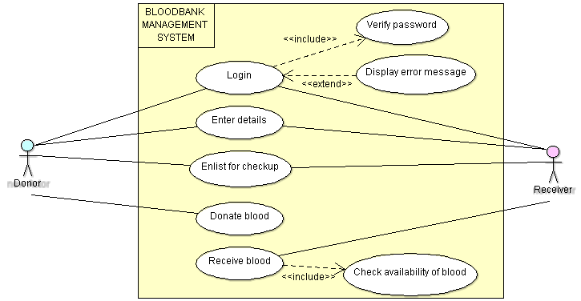
SYSTEM DESIGN – Use Case

Slide 6
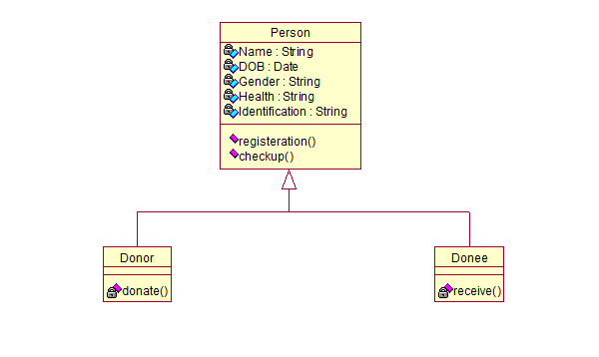
SYSTEM DESIGN-Class

Slide 7
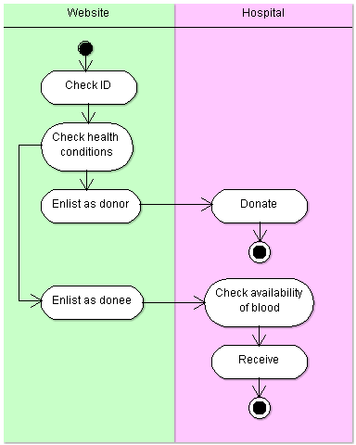
SYSTEM DESIGN - Activity

Slide 8
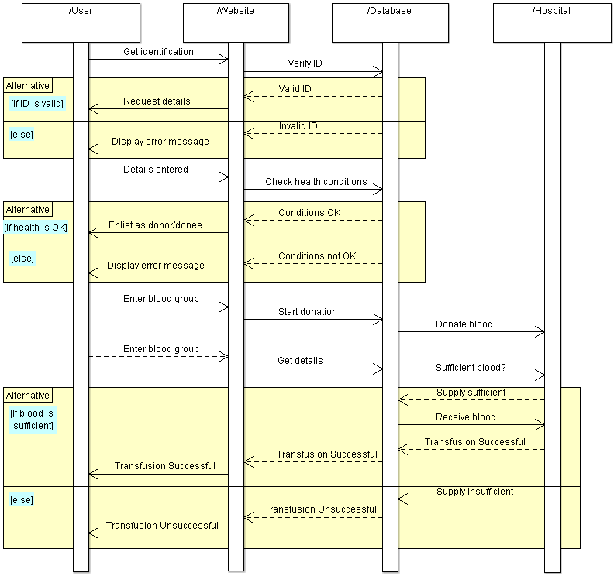
SYSTEM DESIGN - Sequence

Slide 9
PROPOSED SYSTEM DETAILS
The different end users are listed below.
Hospital Administrations:
• To effectively reach the registered donors through Emails or texts, also for the unregistered potential donors through our social media notifications.
• To keep track of the availability of particular blood groups.
Local NGO’s:
• These organizations can partner with the hospitals (rural areas specifically) to create awareness among the people by organizing different campaigns to donate blood.
• NGO’s can bring in bulk registrations, and the people registering for Blood donation camps of NGO’s will get default registered under our website.
Individual Donors and Receivers:
• To retrieve information of the receivers from our website, and vice versa.
Web developers:
• They are the people who develop the website where all the information is being posted.

Slide 10
PROPOSED SYSTEM DETAILS
The different functionalities are listed below:
DESCRIPTION: Names and details of the donors and donees are being posted on the website for information.
CHECKUP: Donors should be tested for their health conditions by checking if they suffer/have suffered from any diseases before they donate blood. This ensures that the blood is safe and secure.
DONATION: This is where the donors donate their blood in different locations like health centers and clinics, NGOs.
LINKING: Blood banks, health centers and clinics are all linked.
RECEIVING: Donees can easily find their suitable donor by efficient searching of the list of donors in the system by checking different criteria.

Slide 11
THANK YOU

